Slide 1
Control Systems
EE 447 Fa19 TuTh 12:30—2:20p DEN 303
Prof Burden
(Sam; he/him/his)

Slide 2
why take this course?

Slide 3
This course focuses on analysis and design of (linear) feedback control systems.
You will learn to understand and engineer control in robotics, embedded systems, electrical circuits, power systems, and biology.
We’ll build on your background in calculus, signal processing, and linear algebra, providing new analytical and computational tools.

Slide 4
learning outcomes
by the end of this course, you will be able to:
represent a linear system in state space and transfer function form;
determine the effects caused by including feedback in a system;
linearize a nonlinear system around an operating point;
determine if a system is stable;
understand sensitivity and noise/disturbance rejection properties;
apply scientific computing tools to model, design and simulate systems;
determine the performance of a system analytically and from simulation;
apply root locus, frequency response and full-state feedback methods to design a feedback control system to meet performance requirements;
design a full-state observer for a system;
apply observer + controller to estimate and stabilize a system’s state.

Slide 5
origins of feedback control

Slide 6
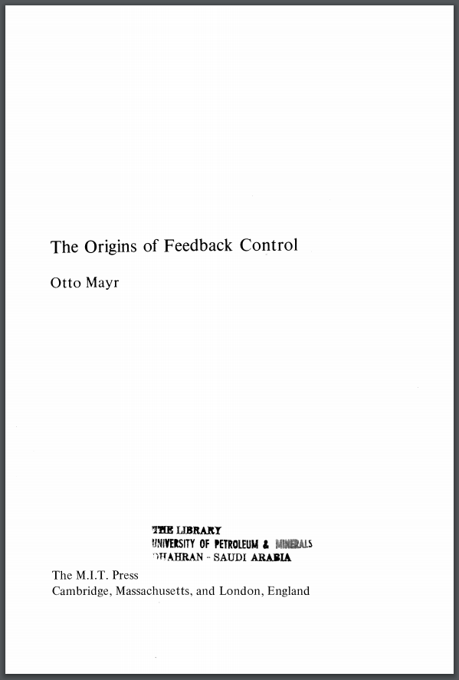
Otto Mayr
“The Origins of Feedback Control”
MIT Press 1970

Slide 7
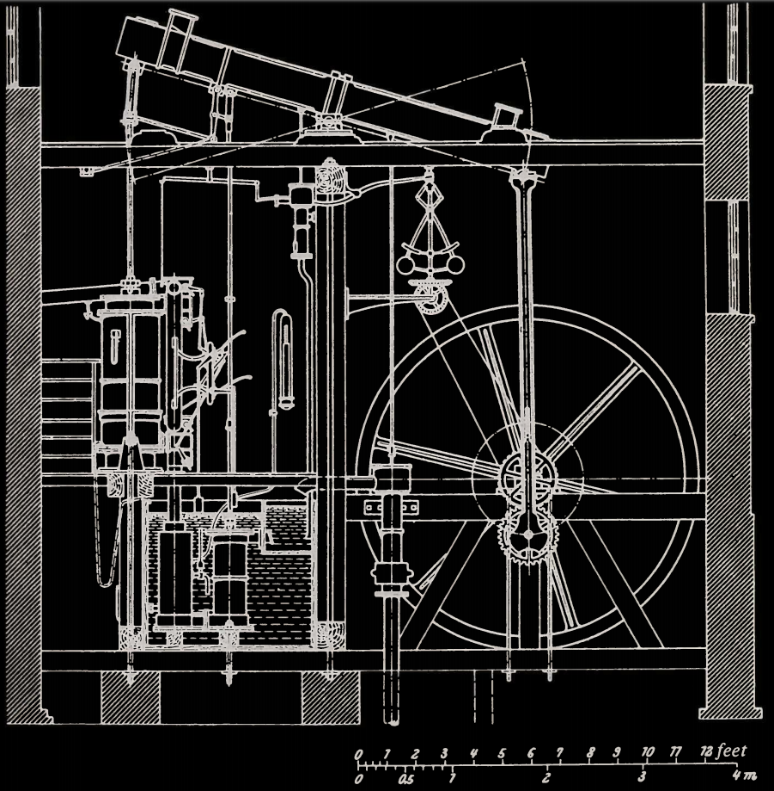
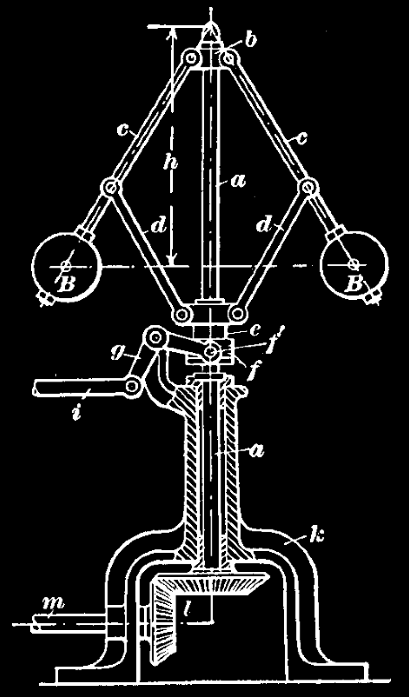
≈1800 CE

Slide 8
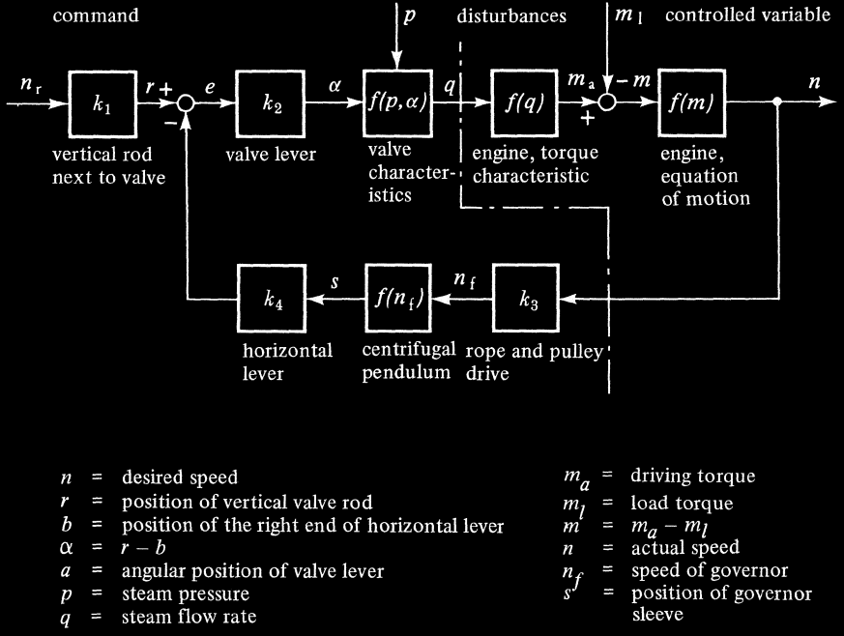
≈1800 CE

Slide 9
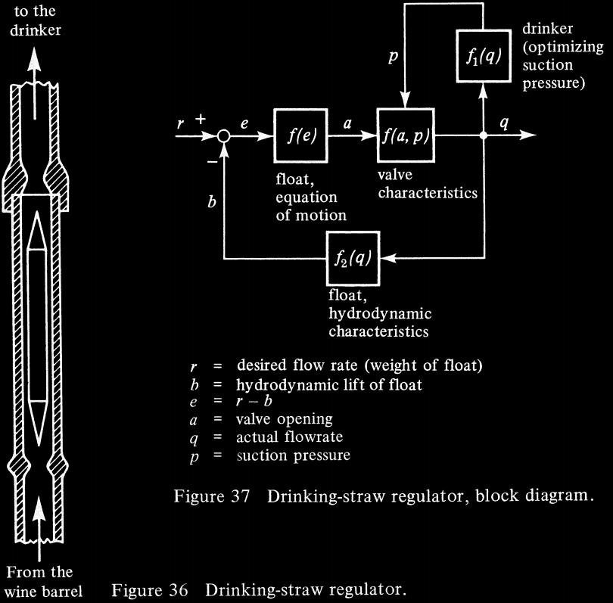
≈1100 CE

Slide 10
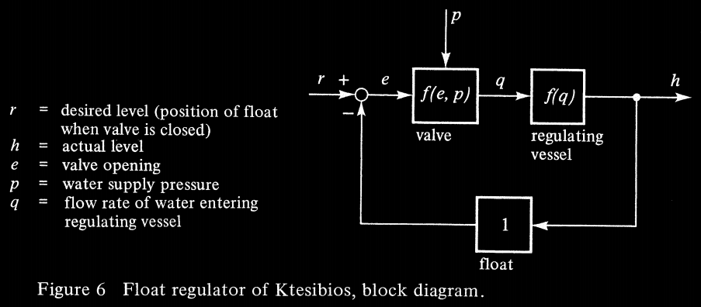
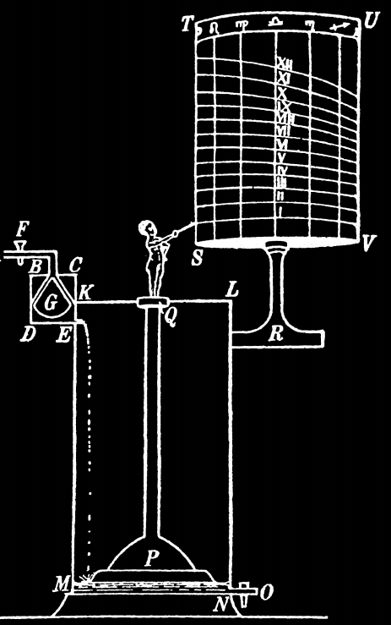
≈300 BCE

Slide 11
state of the art

Slide 12
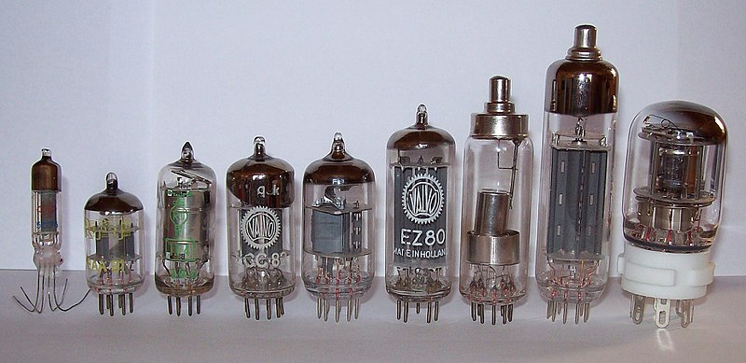
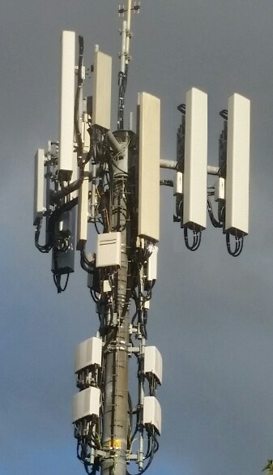
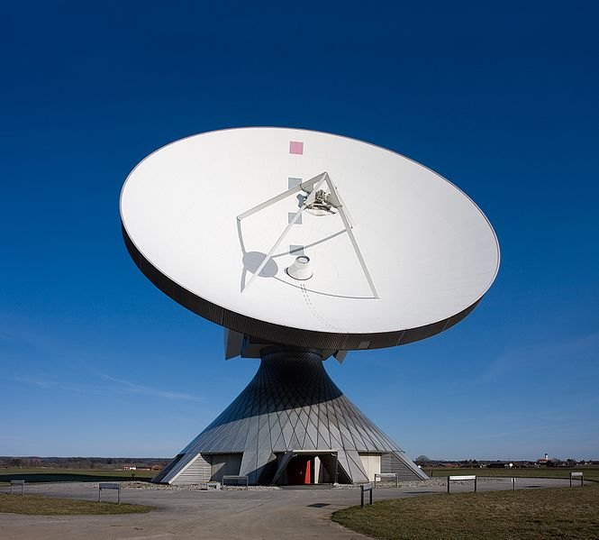
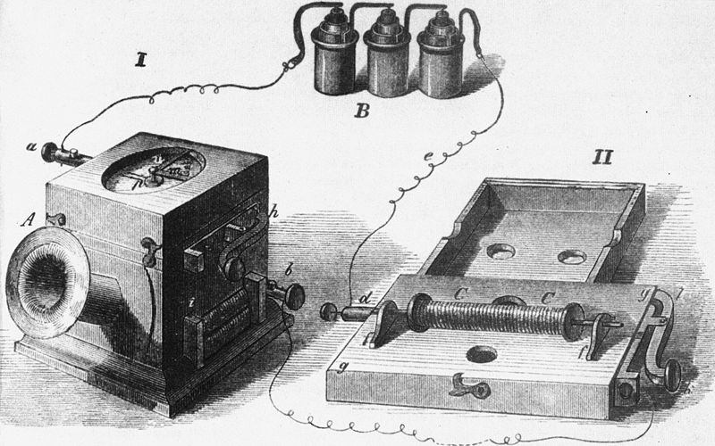
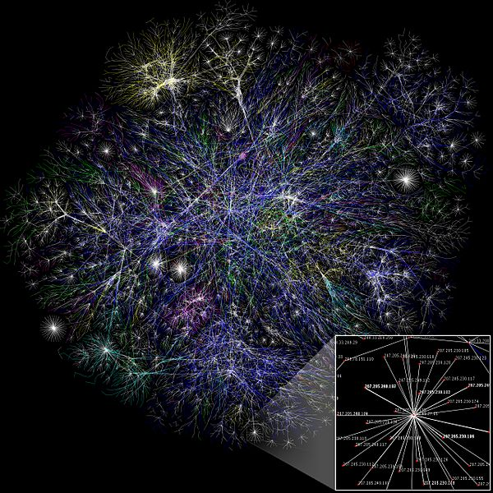
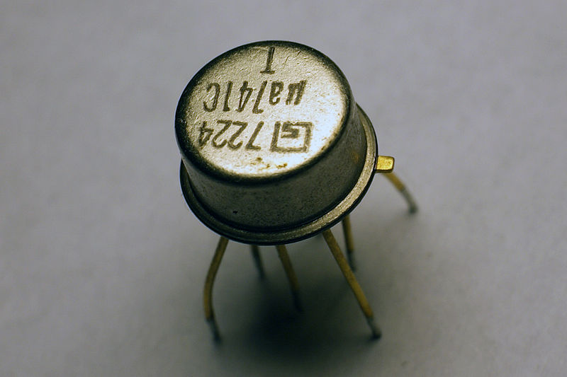
telecommunication

Slide 13
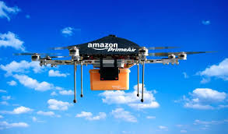
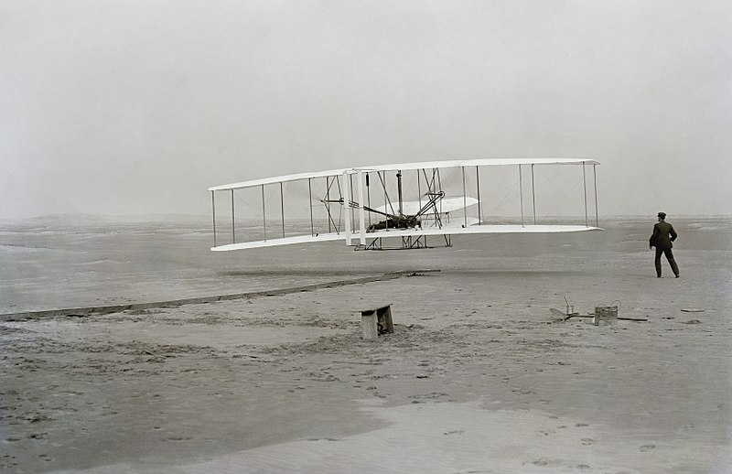
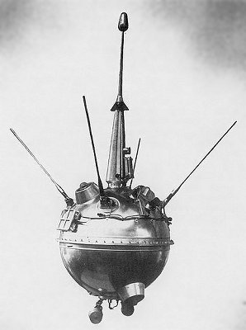
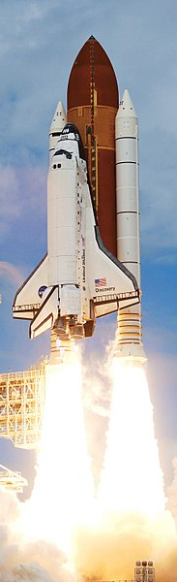
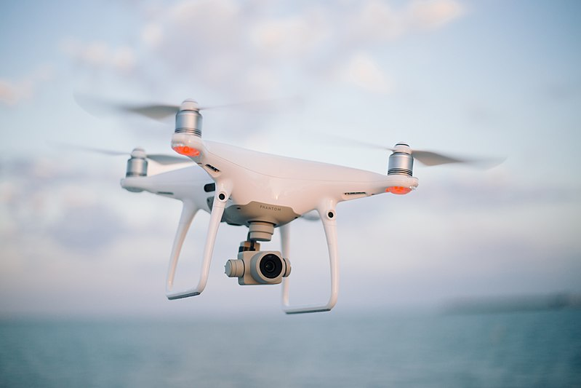
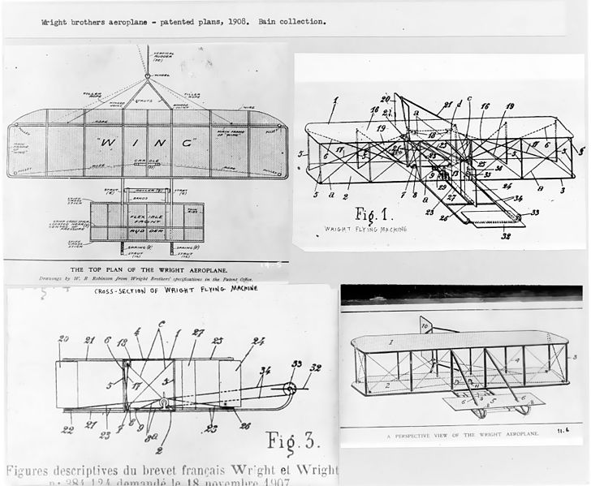
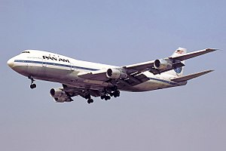
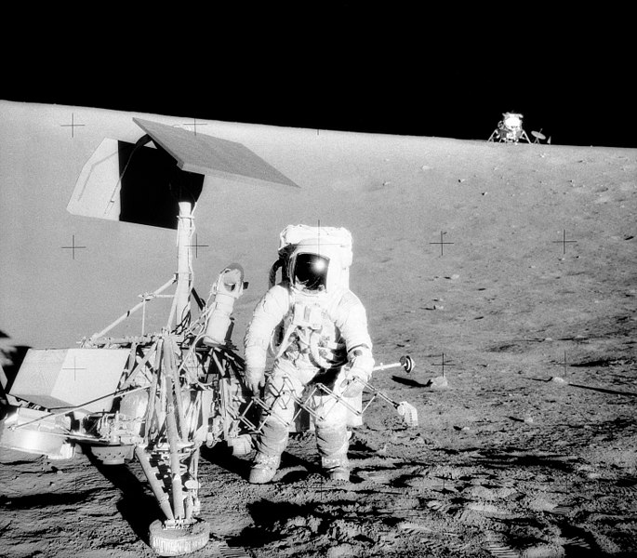
aerospace and transportation

Slide 14
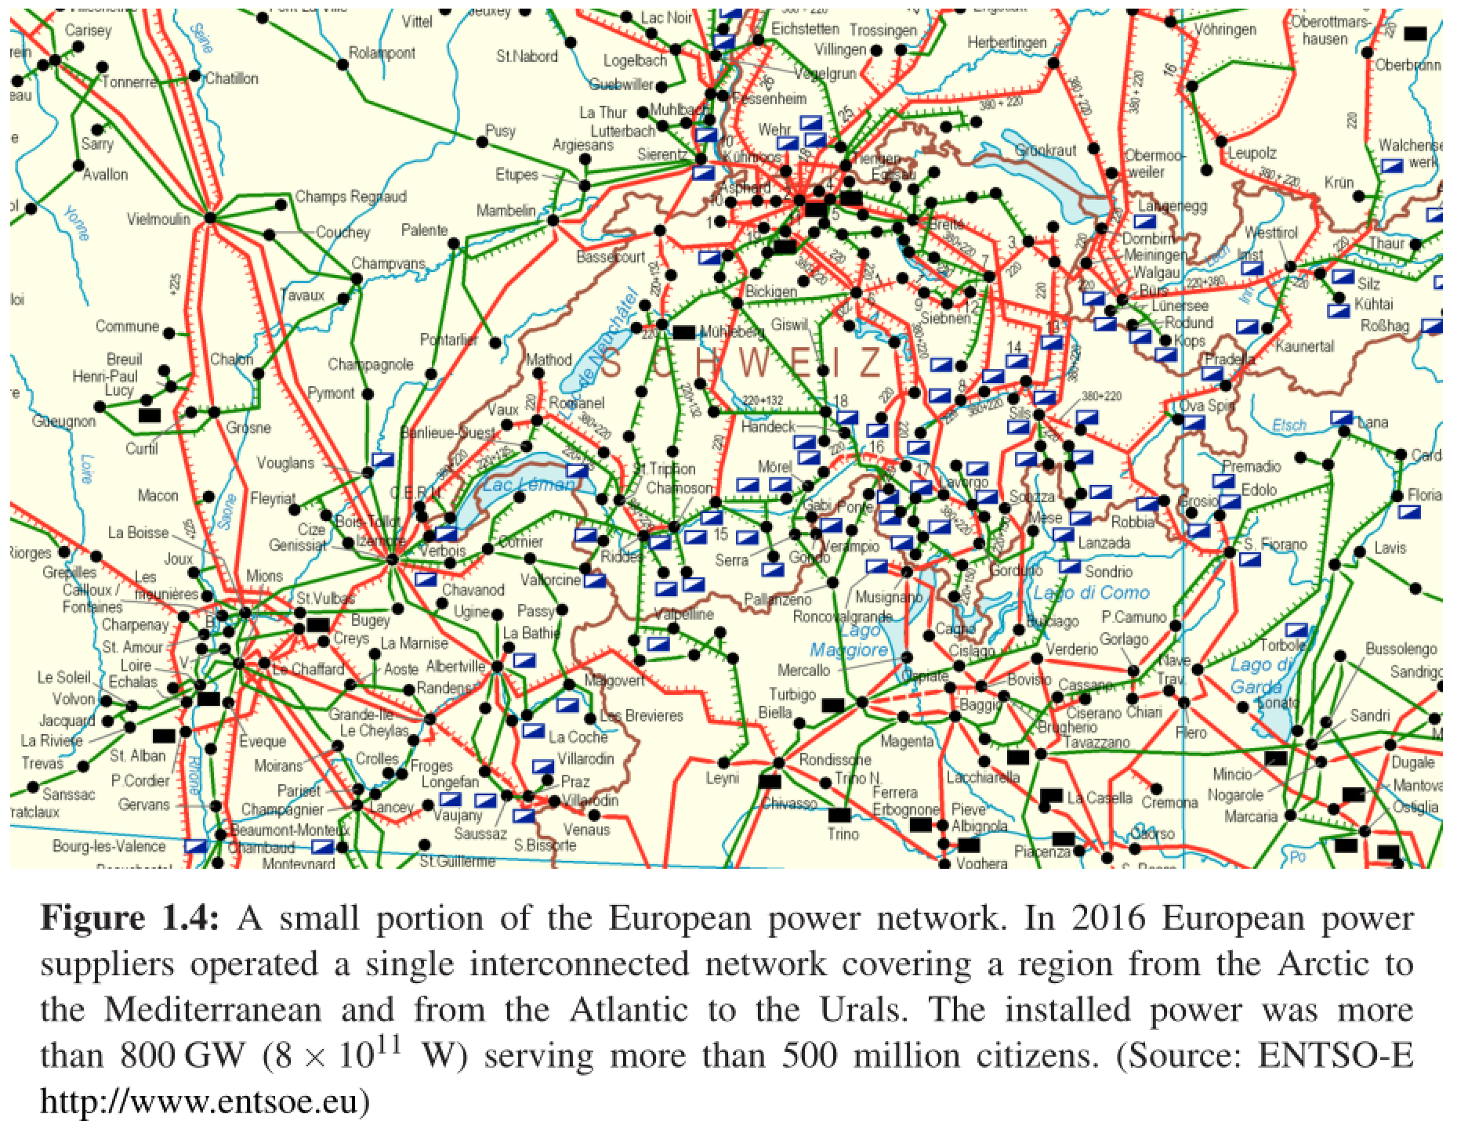
power systems – ECE 458

Slide 15

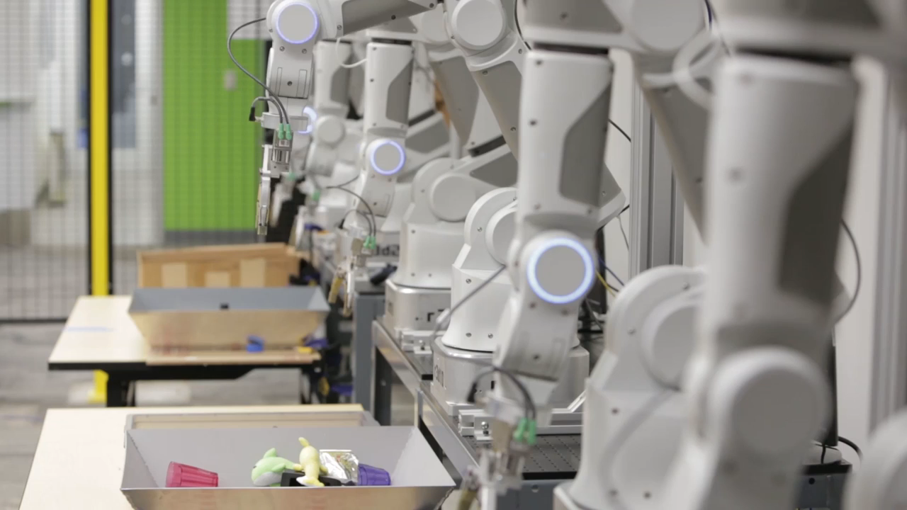

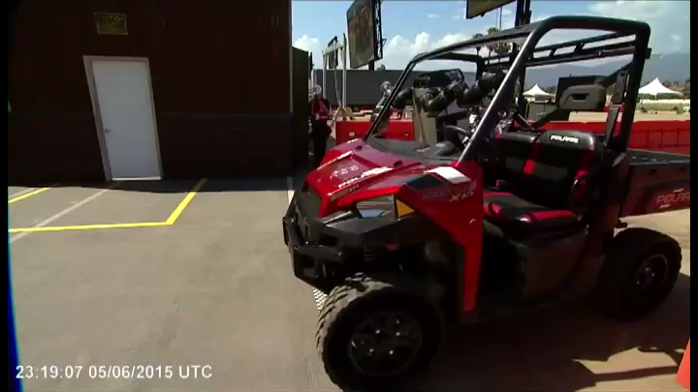
robotics and AI – ECE 448/9

Slide 16
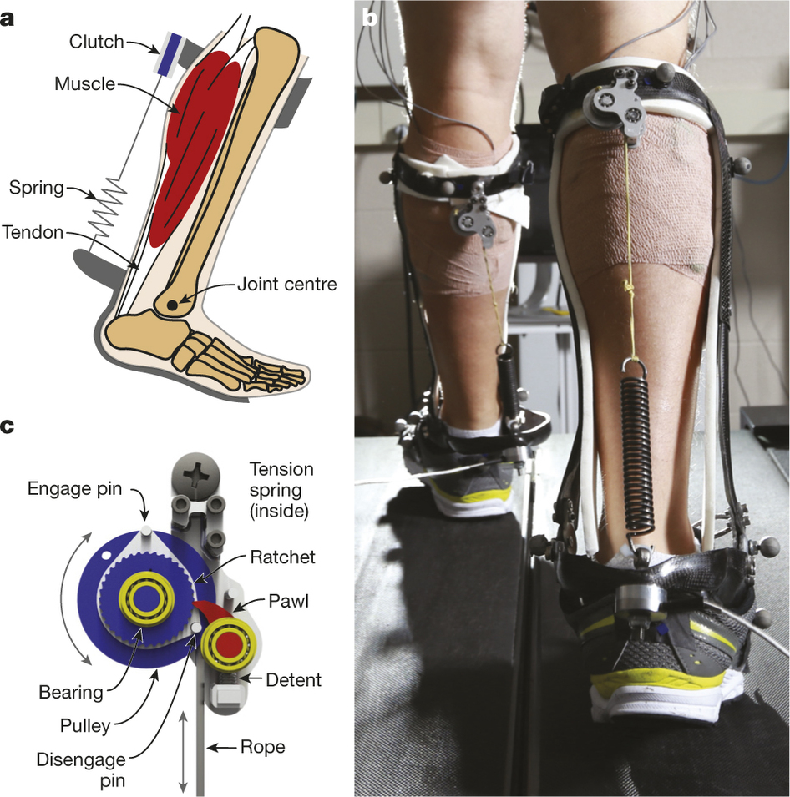
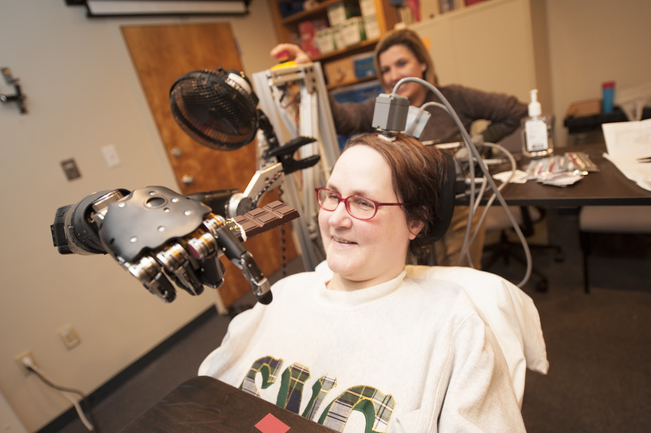
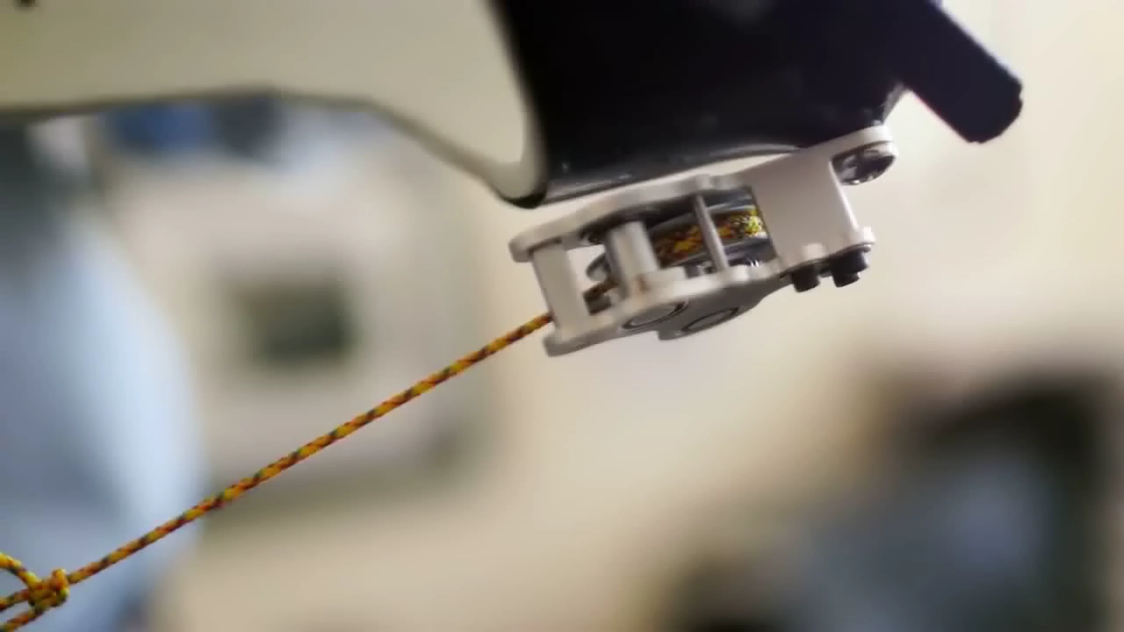
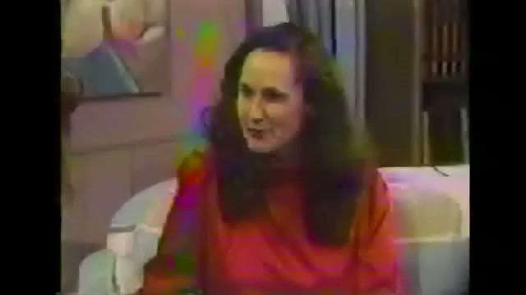
neuroengineering – ECE 466

Slide 17
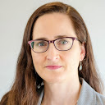
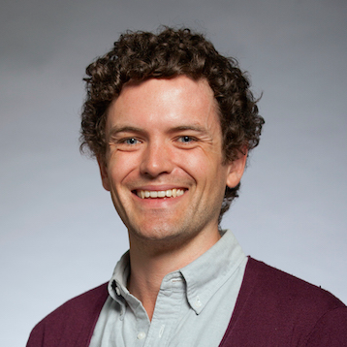
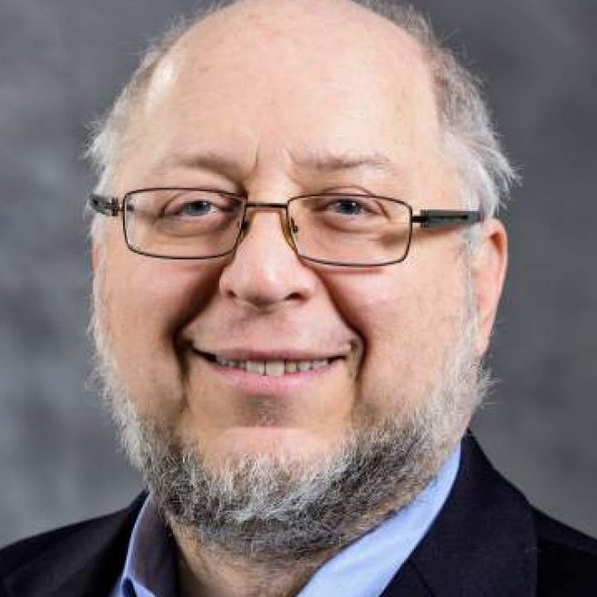
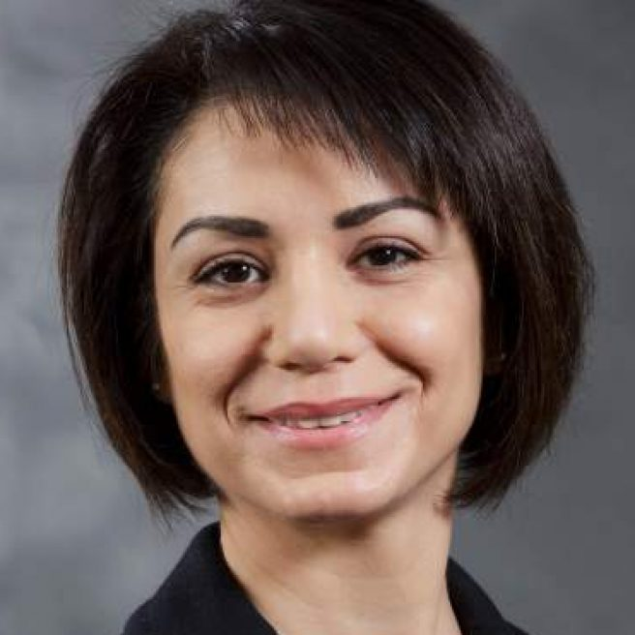
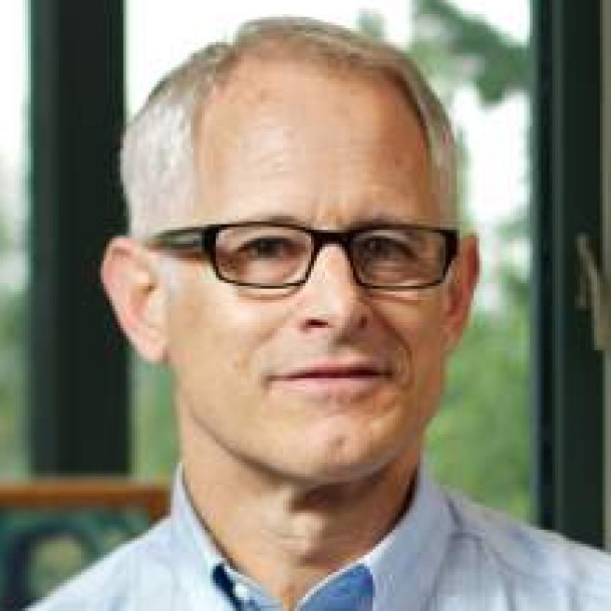

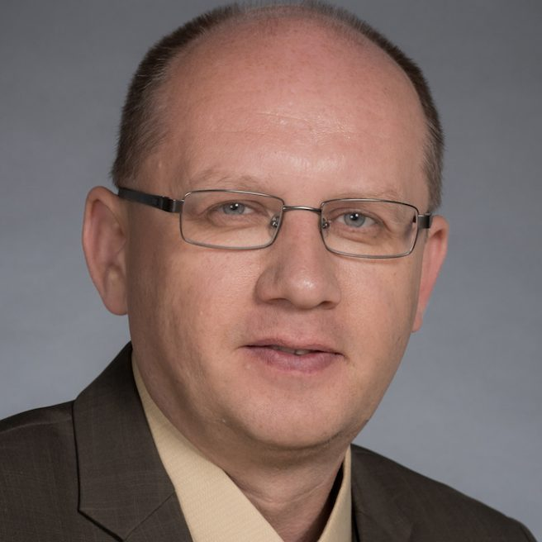
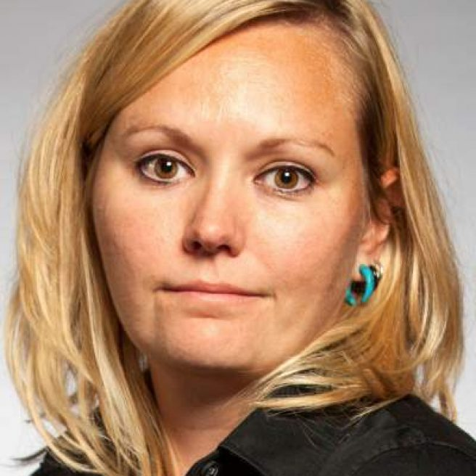
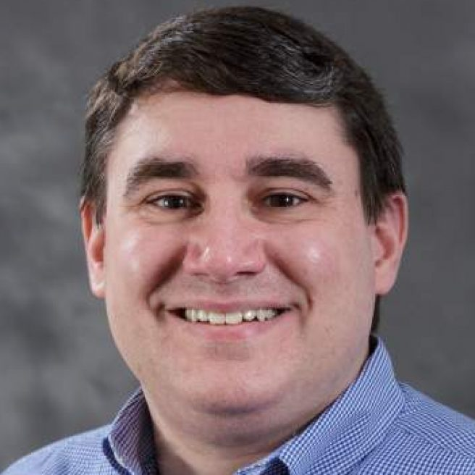
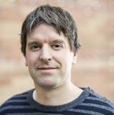
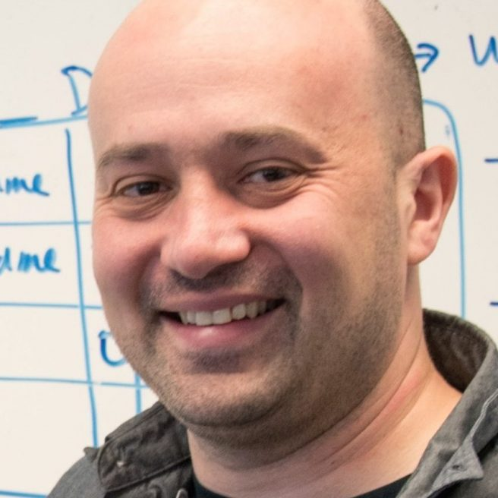
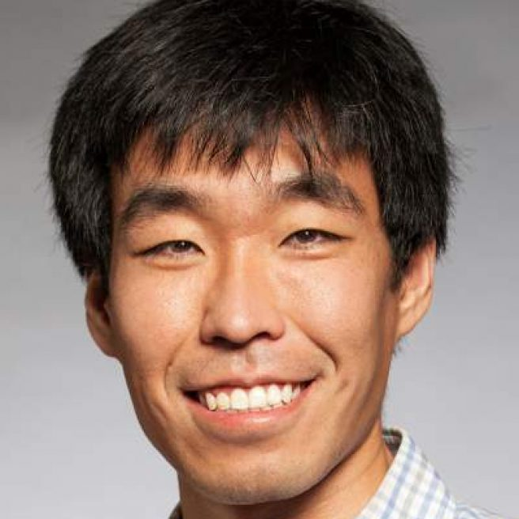
ECE systems / controls / robotics
Prof. Linda Bushnell | networked control, cyber security
Prof. Sam Burden | sensorimotor control
Prof. Howard Chizeck | brain-computer interface (BCI)
Prof. Maryam Fazel | convex optimization
Prof. Blake Hannaford | medical robotics, telerobotics
Prof. Eric Klavins | systems biology
Prof. Alex Mamishev | sensor design and integration
Prof. Lillian Ratliff | cyber-physical systems (CPS)
Prof. Matt Reynolds | ultra-low power sensing, computation
Prof. Georg Seelig | systems biology
Prof. Eli Shlizerman | data-driven dynamical systems
Prof. Baosen Zhang | cyber-physical systems (CPS)

Slide 18
why take this course?

Slide 19
This course focuses on analysis and design of (linear) feedback control systems.
You will learn to understand and engineer control in robotics, embedded systems, electrical circuits, power systems, and biology.
We’ll build on your background in calculus, signal processing, and linear algebra, providing new analytical and computational tools.

Slide 20
learning outcomes
by the end of this course, you will be able to:
represent a linear system in state space and transfer function form;
determine the effects caused by including feedback in a system;
linearize a nonlinear system around an operating point;
determine if a system is stable;
understand sensitivity and noise/disturbance rejection properties;
apply scientific computing tools to model, design and simulate systems;
determine the performance of a system analytically and from simulation;
apply root locus, frequency response and full-state feedback methods to design a feedback control system to meet performance requirements;
design a full-state observer for a system;
apply observer + controller to estimate and stabilize a system’s state.

Slide 21
life outcomes
by the end of this course, you will be able to:
translate the physical world into equations
transform the equations to do anything you want
in effect, you will be able to …
… Control Systems
EE 447 Fa19 TuTh 12:30—2:20p DEN 303
Prof Burden
(Sam; he/him/his)
… Control Systems
EE 447 Fa19 TuTh 12:30—2:20p DEN 303
Prof Burden
(Sam; he/him/his)
… Control Systems
EE 447 Fa19 TuTh 12:30—2:20p DEN 303
Prof Burden
(Sam; he/him/his)

